Slide 1
NH Traffic Data & Insights
By Heather, Meagan, johnny, and neha

Slide 2
Intro
Data obtained about traffic stops in NH
2014 – 2015
Too much data to manually sift through
Interested in providing insight
Used R

Slide 3
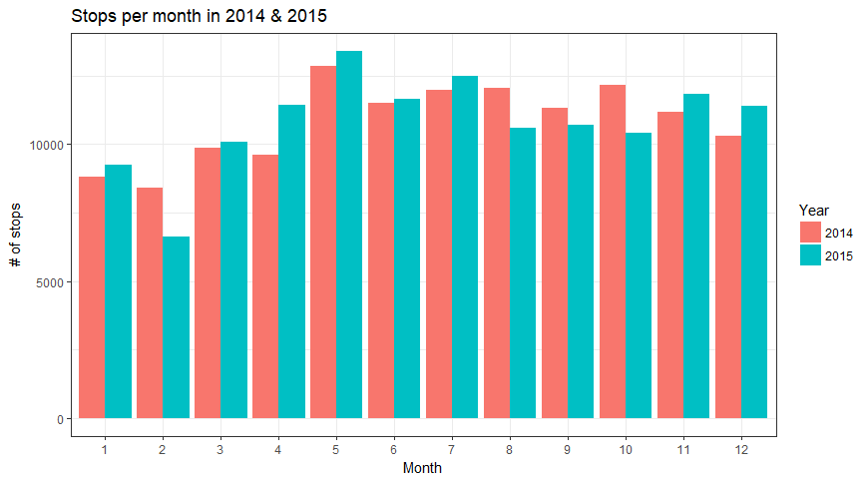
12845
13395
8422
6639

Slide 4
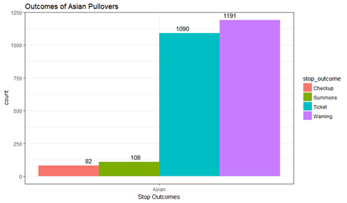
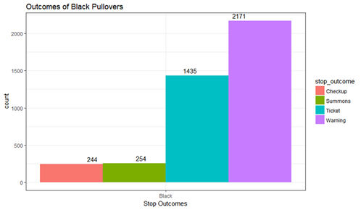
Stop Outcome for Asian & Black Drivers

Slide 5
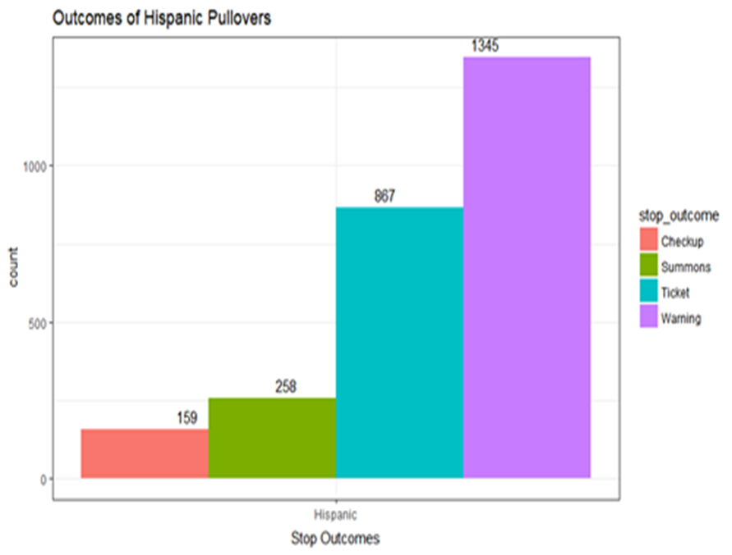
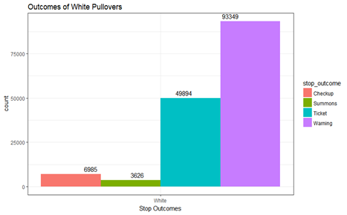
Stop Outcome for Hispanic & White Drivers

Slide 6
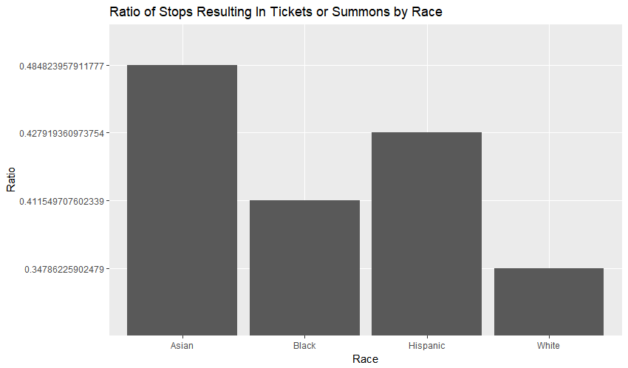

Slide 7
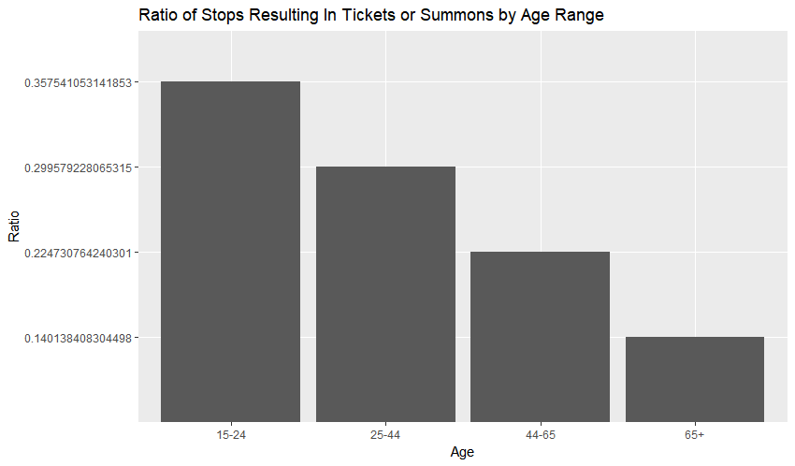

Slide 8
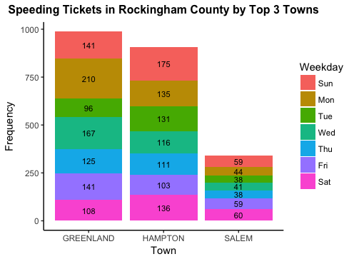

Slide 9
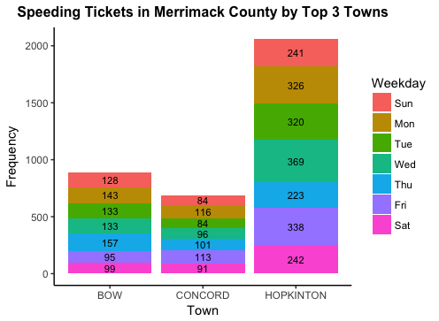

Slide 10
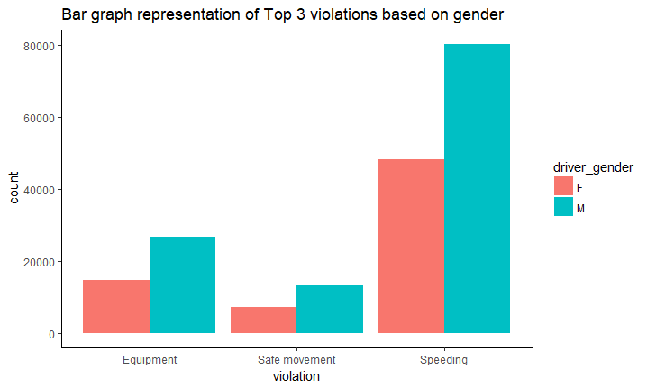

Slide 11
